Slide 1
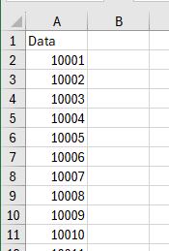
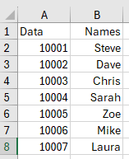

How to create a CSV file
Open a new Excel sheet.
In the first cell (A1) add a column header. You can name this anything you like.
Underneath the header list your data. As you have a column header in the first row you will need to run your data to one extra. For example, if you need 50 cards, make sure you complete rows with data down to row 51.
Complete a new column for each new piece of data. (Image 2)
When complete, save the file as a CSV (Comma delimited) (*csv) ready to upload within the design page.
(Image 3)
Image 1
Image 2
Image 3

