Slide 1
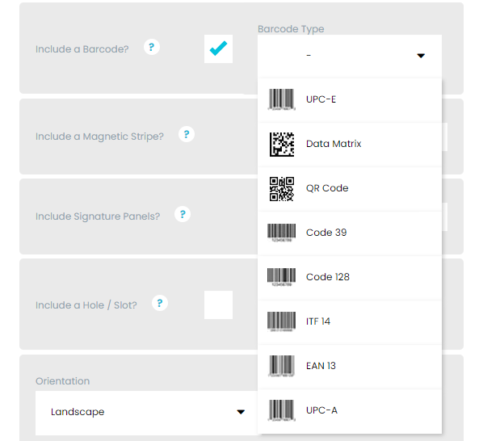


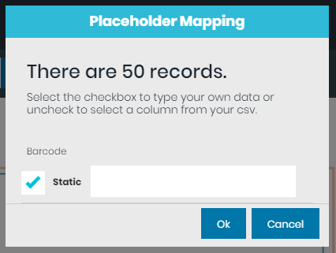
Linking a barcode to a card
On the quote page, select the barcode you require
Upload Data (CSV file)
Select your CSV file you have prepared.
Press Link barcode/encoding fields
Untick the ‘Static’ field

Slide 2
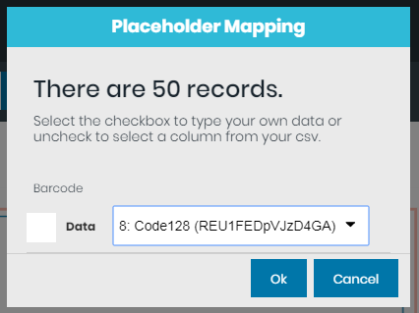
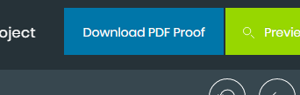
Select your column header from the drop-down options and press ok.
You should see a yellow box appear in the top right-hand corner that says ‘Mapping saved’ – This is showing that the data has been linked.
Press the Download PDF proof button when the yellow box appears, then press the blue text ‘Download PDF Preview’

Slide 3
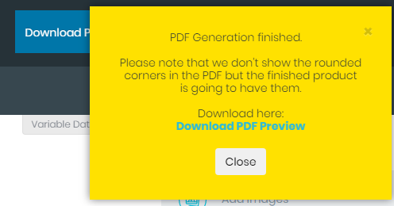
You should now see in the downloaded image, the first 12 x cards with your barcodes. Ready for checking and test scanning.

