Slide 1
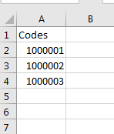


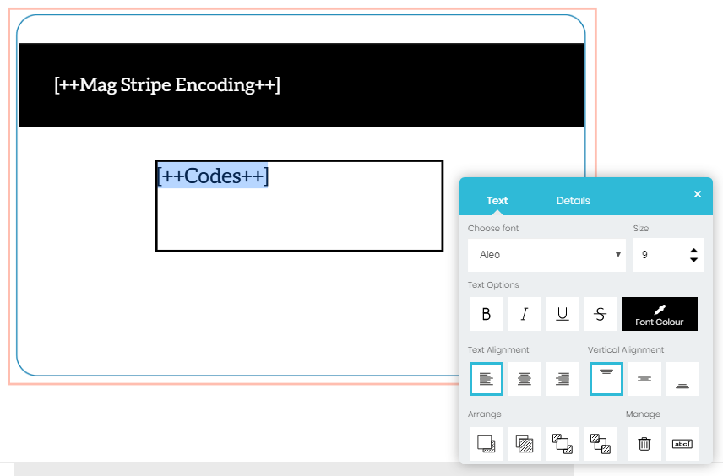
How to link your data
Before you upload the data, please ensure you have included a column header in your csv. file.
Press Upload Data (csv file)
Select your csv file from your saved location.
Select your required column from the drop-down option and press ‘Use field’
The column / data should appear on the cards (leave the brackets and + symbols, they will disappear when printed)
Highlight the data to re-size and reposition as required.

Slide 2
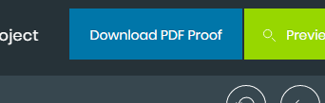
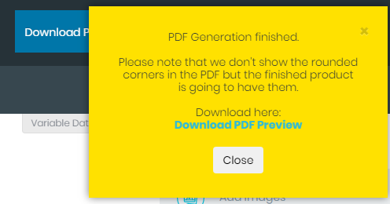
Happy with the location of your data? Then press the Download PDF proof button. Once the yellow box appears, press the blue text ‘Download PDF Preview’
You should now see in the downloaded, the first 12 x cards with your variable data visible and ready for checking.

